Slide 1
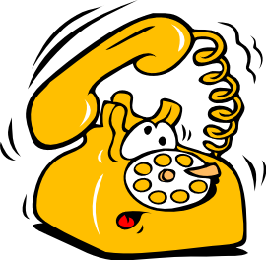
Telephone Etiquettes
Updated July 2014
This document is confidential and contains proprietary information, including trade secrets of CitiusTech. Neither the document nor any of the information contained in it may be reproduced or disclosed to any unauthorized person under any circumstances without the express written permission of CitiusTech.

Slide 2

Course Content
Introduction & Importance
Why Telephone?
Telephonic Impression
Qualities of a Good Voice
Calling Process/Structure of Business Calls
Requisites for Effective Telephonic Conversation
Telephonic Calls – Framework
Structure of Business Calls
Follow Up on your Calls
Do’s & Don’ts
Challenges
Handling Furious Calls
Voicing Opinions on Calls
Saying “No”
General
Mobile Phone Etiquettes In Office
Taking Calls For Others
Leaving Messages

Slide 3
Telephone Etiquettes Introduction & Importance…
Why Telephone?
Telephonic Impression
Qualities of a Good Voice

Slide 4

Why Telephone???
Personalized Form of Communication
Easier & faster rapport building with the receiver
Immediate feedback from the other end
Adequate amount of information conveyed
Control over delivery of message
Scenarios/situations in which you would prefer Telephonic conversation instead of an email conversation…

Slide 5
Did you know??
The impression/feeling the receiver gets in telephonic conversation:
Conveyed by words = 20%
How you speak – tone, volume… = 30%
Body Language = 50%

Slide 6
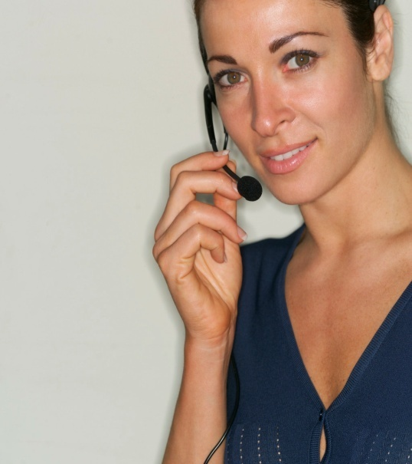
Qualities of a good voice
Alertness : Show that you are wide awake, ready to help
Expressions : Talk at a moderate rate and volume, vary the tone of your voice
Naturalness : Use simple language, avoid technical jargons and slang
Pleasantness : Put a smile in your voice and sound welcoming
Distinctness : Speak clearly and concisely

Slide 7
Telephonic Etiquettes to be followed for calling process…
Requisites for Effective Telephonic Conversation
Telephonic Calls – Framework
Structure of Business Calls
Follow Up on your Calls

Slide 8

Requisites for Effective Telephonic Conversation
Physical preparation of the call
Preparation of information for the call
Mental & Emotional preparation for the call
In Short …..just remember …..
“ The 3 Ps”
Plan – Prepare - Process

Slide 9

Telephonic Calls – Framework
Greeting
Establish Identity
Stating Purpose
Exchanging Information / Probing – Supporting
Pre Closing Courtesy
Closing with Action

Slide 10
Structure of Business Calls (1/2)
It is a 4 step process
CLOSING
Close
for
Action
Solutions,
Suggestions
SUPPORTING
PROBING
Uncovering the Needs
Agenda, Open the discussion
OPENING
Greet, Identify, Small Chat

Slide 11

Structure of Business Calls (2/2)
Step 1: OPENING
Propose an Agenda
State the Value
Check for Acceptance
Step 2: PROBING
Uncovering the needs – Clear, Complete & Mutual Understanding of callers need
Step 3: SUPPORTING
Acknowledging
Describing relevant solution
Check for Acceptance
Step 4: CLOSING
Review previously accepted benefits
Propose the next step for you and the caller
Check for Acceptance

Slide 12

Follow Up on your calls
Request for mutually suitable time (schedule) by email / phone
Send email / calendar invite of schedule with agenda of discussion
During the follow up call-
Give summary of events
Highlight the completed actions
Give status of incomplete job & steps to progress
Discuss if any challenges
Ask for suggestions / Support
Close for next action Step

Slide 13
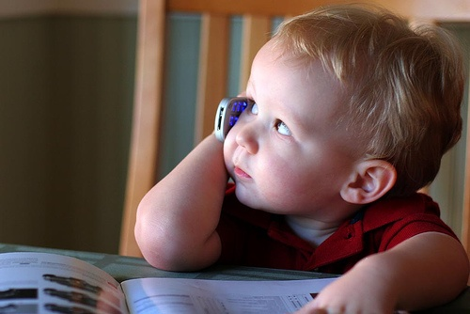

Telephonic Etiquettes to be followed for calling process…
Dos and Don’ts
during
Telephone Calls!!!

Slide 14

Dos…
Smile
Identify yourself
Converse with clarity
Effective listening
Show concern towards callers
Be alert & active
Use simple language without jargons
Extend help – Build Trust & Confidence
Effective Questioning: Information – Confirmation
Voice Modulation – Pitch, Volume, Rate of Speech / Clarity, Diction
Information that suits receiver’s needs
Demonstrating the importance / urgency of issues
Consider Caller/Receiver’s need for privacy

Slide 15
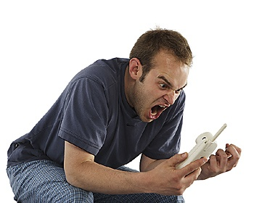
Don'ts…
Be irresponsible
Arguments
Emotional outbursts
Be unsure
(In such case say “I shall get back to you”)
Interrupt the caller when speaking
Raise your volume when things unclear
Cut the phone when caller is speaking or without letting him complete
Eating during conversation
Laugh & Giggle and irritate Callers
Put on hold unnecessarily
Slam the phone

Slide 16
Telephonic Etiquettes challenges…
Handling Furious Calls
Voicing Opinions on Calls
Saying “No”

Slide 17
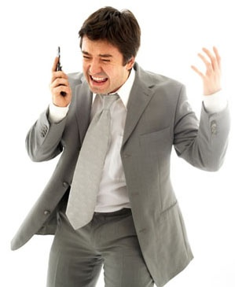
Handling Furious Calls
Listen carefully
Convey sincere interest and be empathetic
Agree as often as possible
Remain calm and courteous. Do not Argue!
Do not interrupt unless the person needs to talk to another person or department
Do not blame co-workers
Explain clearly and be anxious to solve the problem or correct mistakes
Do not make unrealistic promises
Apologize. Be sure to say I'm sorry. To a customer that is more sincere than we are sorry
Act fast. Acting quickly shows that you are sorry and that you will handle the issue
Follow up. Get back to the caller to make sure the problem has been solved

Slide 18



Voicing Opinions on Calls….
Opinions
Similar
Tentative
Different
Positive Acknowledgement
I agree with what you are saying…
I can understand why you are saying…?
I observe a difference in…
Probing
Is here something we need to consider before…?
Could you explain…?
What are the reasons for…?
Supporting
Encourage to bring about a difference towards constructive best solution
Firm up differences by first summarizing agreed points, & then discuss next best alternative
Use solution centric language towards issue in discussion & discuss other different ways to arrive at next best alternatives
Closing
Summarize for action steps

Slide 19

Saying “NO”
Direct Refusal
Partially Provision
Contract Out
Broker Out
Deferral
Coaching
“NO”
“I will do part of it”
“I will give you some names of people you can contact”
“I will find someone who does high quality work, and will coach or work with him / her”
“I can’t do it now, but later”
“I can do part now and part later”
“I can help you or your people to do it”
An outright no, without options.
This is your last resort.
Depending on how much you commit to, this can, in fact, range from close to a No to a virtual yes.
Contracting out refers your client to another provider who may be available or more appropriate as a service provider
Brokering out is a way to service & interface with your client but utilize a third party to actually perform the work for you under your guidance
Be careful if you use this option because you are, in fact, saying a future yes.
With source resources, helping your clients to help themselves may be a good long term strategy

Slide 20
Telephonic Etiquettes to be followed in general…
Mobile Phone Etiquettes In Office
Taking Calls For Others
Leaving Messages

Slide 21
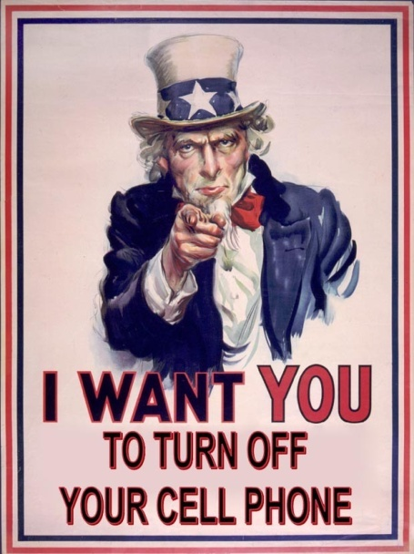
Mobile Phone Etiquettes In Office…
Low Phone Ringer
Caller Tune inline with Corporate Styles (Office Mobile Numbers)
Don’t get lost in local language
Don’t laugh loudly
During Meetings – Switch Off / Vibrate Mode
Take Permissions during meetings / discussions
No calls in organizational gatherings
Don’t leave on your desk
Be brief

Slide 22

Taking Calls For Others
Identify yourself and the person for whom you are answering
Offer assistance in the absence of others
e.g. "She is not in today, perhaps I can be of assistance“
Do not make commitments for others
Note accurately & legible messages with details of
Best number (and an alternate)
Time & date
Reason for call
Urgency
Company represented (if any)
The best time to reach them
Any other pertinent information

Slide 23
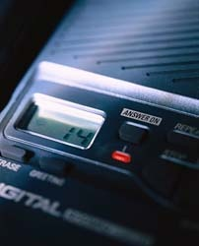
Leaving Messages
Speak slowly & discretely
Identify your name – pronounce your name clearly
Give your company name, designation & why you are calling
Keep your message short & simple
Let them know when to call you back
Slow down when saying your telephone number
Avoid ‘filler sounds’
Always sound professional

Slide 24
Lets Recap
Introduction & Importance
Why Telephone?
Telephonic Impression
Qualities of a Good Voice
Calling Process/Structure of Business Calls
Requisites for Effective Telephonic Conversation
Telephonic Calls – Framework
Structure of Business Calls
Follow Up on your Calls
Do’s & Don’ts
Challenges
Handling Furious Calls
Voicing Opinions on Calls
Saying “No”
General
Mobile Phone Etiquettes In Office
Taking Calls For Others
Leaving Messages

Slide 25

Time for your views…

Slide 26
Thank You

